Slide 1
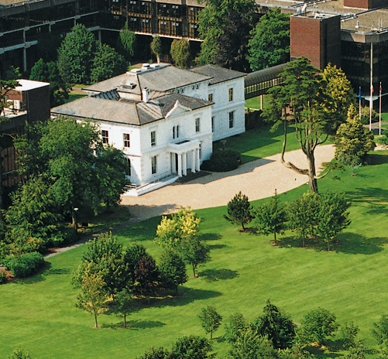


SOFTWARE PROJECT MANAGEMENT
Software Project Management in practice
Case Study
John Dawson MSc
Sub Heading
And Date

Slide 2

What is Project Management?
Taking responsibility – for a project
Being accountable – to your manager(s), to your customer(s)
Managing other people
Manager(s)
Customer(s)
Project Manager
Staff
Staff
Staff
John Dawson MSc Guest Lecture: Project Management 22nd November 2010
Notes:
“Piggy in the middle”

Slide 3
Project Management: Overview
Taking responsibility – for a project
  It’s no-one else’s fault – The buck stops here (Harry S. Truman)
  Taking responsibility for events over which you have only partial control
Managing conflicting pressures
  Managing time – They want it yesterday
  Managing a budget – They want it for half nothing
  Managing scope – They want all the features
  Managing quality – Few bugs / Rapid turnaround / No showstoppers
  Managing people – Keep most of them happy – most of the time
John Dawson MSc Guest Lecture: Project Management 22nd November 2010
Notes:
Time / Budget / Scope / Quality considered an invariant combination i.e. change one, affects others!

Slide 4
Project Management: Planning & Iteration
Project planning: make a list of jobs to be done
At first, many will be “fuzzy” – i.e. not well defined
Gradually, “ fuzzy” jobs become well defined – plan improves
“Concrete” jobs may be estimated; “fuzzy” jobs: “guessimated”
“Fuzzy” jobs “Concrete” jobs
John Dawson MSc Guest Lecture: Project Management 22nd November 2010
Notes:
Using spreadsheet type tool, fuzzy jobs can be treated as headings, later to be refined into a list of smaller jobs, which can be done in a defined time

Slide 5
Project Management Case Study: Overview
Small software company
Problems, consequences, innovations, lessons ...
Lack of key processes and support for them causes many problems, most of which can be circumvented, but (initially) only at cost of excessive and un-sustainable time & effort
Key initiatives: 1) Configuration management 2) Support for testing, particularly data quality 3) Good project management 4) Appropriate documentation
John Dawson MSc Guest Lecture: Project Management 22nd November 2010

Slide 6
Case Study: Company Overview
20 employees co-located, another 20 elsewhere
Shop-floor systems for warehousing, logistics and distribution
  Customers typically much larger e.g. multi-nationals
  Often interfacing to larger ERP-type systems
Database-centric application, with proprietary technology for mobile (small-screen) devices; using a number of technologies:
  Wireless networks, label printers, other hardware
Combination of software and specialist hardware
Initially immature process; gradual improvements
John Dawson MSc Guest Lecture: Project Management 22nd November 2010
Notes:
Niche market, leveraging investment made by large companies in ERP systems
Wireless networks common now, innovative at the time

Slide 7
Case Study: Typical Project Profile
Duration 6 – 12 months; teams of 2 / 3 – or more
Project “leads” initially handled by salesman
Initial /sales project meeting typically director or salesman / account manager & project manager / technical sales support
Project: Project manager and staff, some part-time, plus occasional specialist technical support
Delivery of: Hardware: server and other hardware, and Software and services: configuration, training, support – services
“Going live” typically a concerted customer / supplier effort, involving significant on-site work
Project manager seeks to “hand-over” project to support – and start the next project
John Dawson MSc Guest Lecture: Project Management 22nd November 2010

Slide 8
Case Study: Project Management – Phases
A combination of “pure” project management and conventional technical / programming role
  Jack-of-all-trades
Handle all phases of a project
  Sales support
  Requirements gathering and agreement
  Design
  Implementation
  Testing
  Planning and executing “go-live”
  Post-live support; handover to support group
Sometimes necessary to handle more than one project at a time
John Dawson MSc Guest Lecture: Project Management 22nd November 2010

Slide 9
Case Study: Project Management Strategies
Customer
  Agree functional specification
    Significant risk: need key decision-makers on board
    Might change, but track and control changes
  Keep the customer busy – and off your back
  Keep the customer informed – no surprises
Planning
  As detailed as possible, jobs preferably a few days or less
  For long projects, include interim milestones / deliverables – to keep customer involved and maintain a sense of progress
  Key issue (for these types of systems) is (customer) data quality; interim delivery maybe allow customer to work on this
Staff
  Try to remove obstacles, so staff can make progress
  Find out what’s going on – and tell them what’s going on
John Dawson MSc Guest Lecture: Project Management 22nd November 2010
Notes:
Maker customer work; pile on actions especially at early project meetings; make them feel you know what’s going on and what will happen

Slide 10
Case Study: Project Management: Project Plan
Considered use of Microsoft Project, but rejected as too clumsy – classic case of “over-tooling” – simpler is better
Preferred use of plain spreadsheet: Microsoft Excel: lightweight, reliable, customisable, no un-needed features
Allows free choice of data recorded i.e. Not just total estimate for a job, but initial estimate, current estimate, final time – allows lessons to be learned – improve estimates next time
Formula allows for useful totals e.g. breakdown of total time by assignee, by phase etc.
Does not support recording of dependencies
Plan not visible to customer, except for delivery & milestones
John Dawson MSc Guest Lecture: Project Management 22nd November 2010

Slide 11
Case Study: Project Management: Tracker
Tool to log bugs / features / issues – of all kinds
Key project management artefact – supplements, even comes to replace project plan as key driver
Also implemented using spreadsheet – similar advantages to project planning: customisable, lightweight, sub-totals etc.
Key plus: using spreadsheet sort / filter tools easy to manage issues i.e. to split & consolidate etc.
Key minus: single user (can’t be shared except read-only), no way of linking to configuration management
Conventional to separate customer and internal issues
John Dawson MSc Guest Lecture: Project Management 22nd November 2010
Notes:
Many tools available for this now esp. Open Source

Slide 12
Case Study: Customer / Functional Specification
Usually serves as a basis for customer contractual agreement
  Customer must sign, hence must have some “ownership”
  But cannot expect customer to abide by document if it is not “fit for purpose”
  Can take some time & effort reach this understanding – risk that customer unwilling to do this, despite need for it
Combination of purely business definition e.g. work practices and functional (semi-technical) definition
  Specific enough to reduce risk, but not too prescriptive
Might go through several versions; successive changes visible
John Dawson MSc Guest Lecture: Project Management 22nd November 2010

Slide 13
Case Study: Other Documents
Specification of Interfaces to other (3rd party) Systems
  Typically technical and detailed, but very limited in scope
Design Specification
  Provides extra information a programmer might need – in addition to the functional specification
  Use hyperlinks to cross-reference → Single point of definition
  Partially relies on “tacit” knowledge, so need only specify the unusual, the complicated, the new, the custom features etc.
Database Design: Graphical Tool: Printout
  Visibility crucial to good DB design → Resilient software
John Dawson MSc Guest Lecture: Project Management 22nd November 2010
Notes:
Single point of definition – eliminate redundancy, hence facilitate change

Slide 14
Case Study: Technical Notes
Unix environment
  Rich suite of software facilities supports tool building
  Line-based – possible to build tools to process any artefact
  Very stable, especially compared to earlier Windows versions
Command line interface
  Fast, cryptic, flexible, unforgiving
  Various tools and facilities enable efficient working, especially with repetitive actions e.g. by view, copy & modify of previous commands and parameterised “aliases” – shortcuts
  Popular with experienced programmers
  Can not support more recent IDE tools
John Dawson MSc Guest Lecture: Project Management 22nd November 2010
Notes:
X versions for use on PC

Slide 15
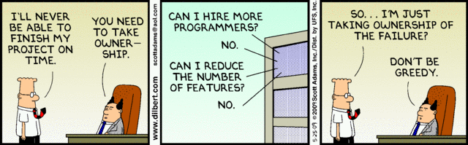
Dilbert on Project Management
John Dawson MSc Guest Lecture: Project Management 22nd November 2010

